Slide 1

Virtual Reality
Notes:
Hey everyone today I’ll be talkling about the wonders of virtual reality.

Slide 2
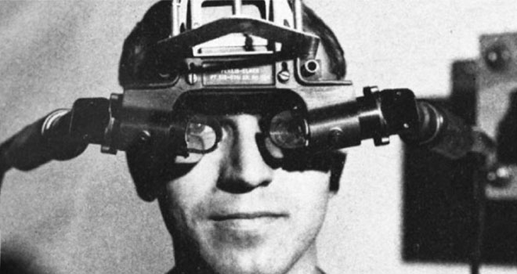
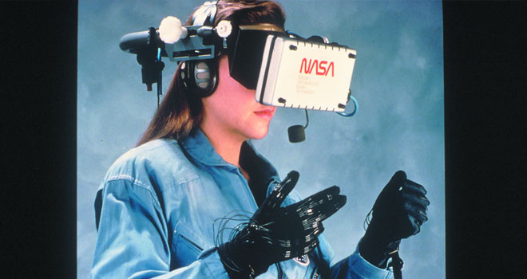
History
Notes:
The use of the term “virtual reality,” was first used in the mid-1980s when Jaron Lanier, founder of VPL Research, began to develop the gear, including goggles and gloves, needed to experience what he called “virtual reality.” Even before that, however, technologists were developing simulated environments. One milestone was the Sensorama in 1956. Morton Heilig’s background was in the Hollywood motion picture industry. He wanted to see how people could feel like they were “in” the movie. The Sensorama experience simulated a real city environment, which you “rode” through on a motorcycle. Multisensory stimulation let you see the road, hear the engine, feel the vibration, and smell the motor’s exhaust in the designed “world.” In the 1970s and 1980s Optical advances ran parallel to projects that worked on haptic devices and other instruments that would allow you to move around in the virtual space. At NASA Ames Research Center in the mid-1980s, for example, the Virtual Interface Environment Workstation (VIEW) system combined a head-mounted device with gloves to enable the haptic interaction.

Slide 3
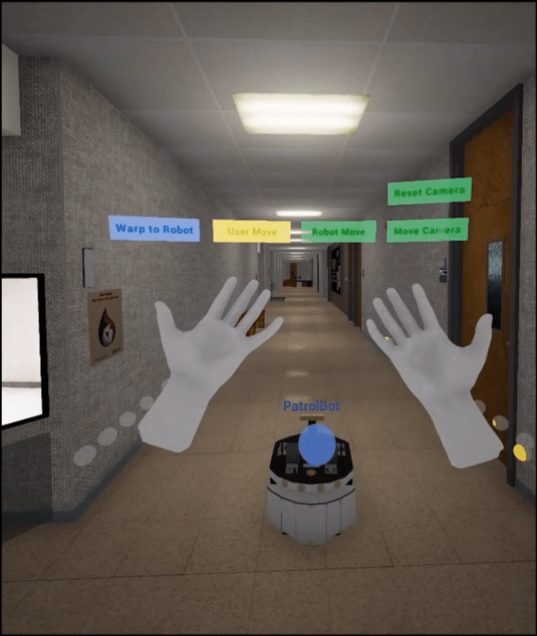
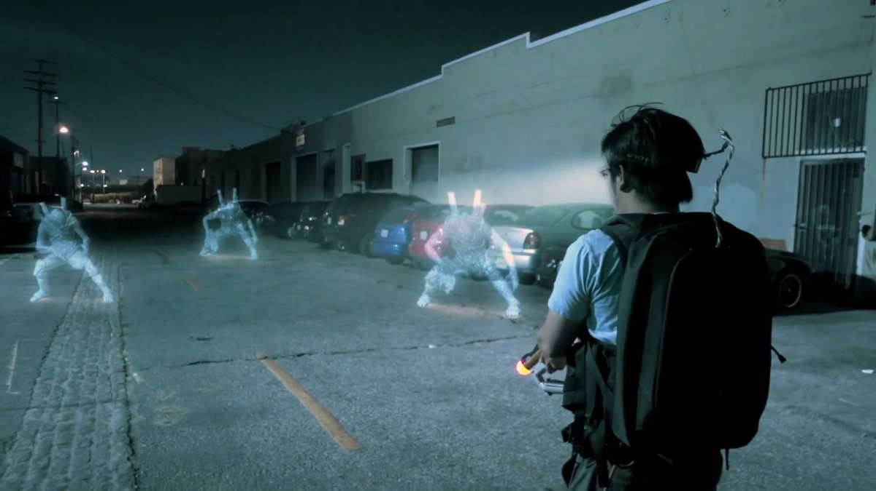
What is it?
Simulation
Powered by a computer
Uses senses
Notes:
So what is virtual reality. Virtual reality is a simulation powered by a computer that lets the user experience things through the senses of the human body.

Slide 4
How is it coded?
VRML
X3d
OpenVR
OSVR
Notes:
In practice, it is difficult to create a good VR environment. A useful standard language to set up a VR world is the language VRML (Virtual Reality Markup Language) along with the standard x3d. 3D scripting languages ​​can be compared to how HTML became known on the internet regarding 2d techniques. With x3d, these languages ​​merge into the new XML language. An example of vrml can be found via the Groninger Museum. In 1999 this museum commissioned Dutch visual artist Martin Sjardijn to build a virtual museum that is accessible via the internet. Since 2015, there has been a strong growth in software development kits for VR environments, partly because VR had a breakthrough in the world of computer games. Some examples of such kits are OpenVR and OSVR.

Slide 5
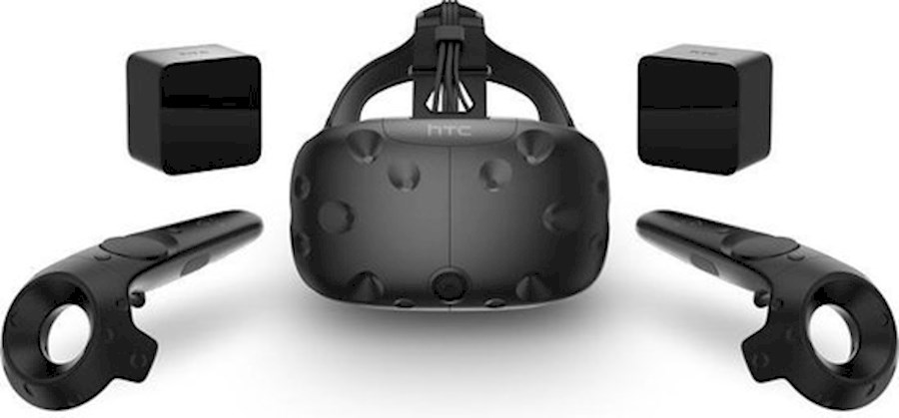
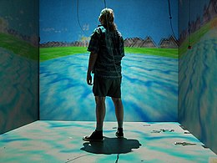
How do you use it?
Peripherals
CAVE
Notes:
But how does it work exactly? The user can use standard peripherals or tools like a Virtual reality headset, movements sensors or even bodysuits to interact with the environment. It also has the same process as any other application so its user friendly most of the time, but movement sensors and bodysuits need to be calibrated to work properly. Beside this there is something called the CAVE. A room that works with projection walls and shutter glasses that the users wear, everything seems to come alive from the walls. Because of the positioning-sensors in the glasses it seems as though everything around you moves relative to you and with the gloves you have the feeling of touching objects.

Slide 6
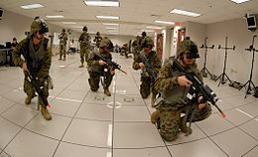
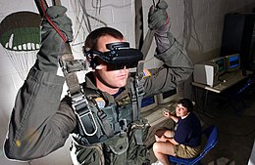
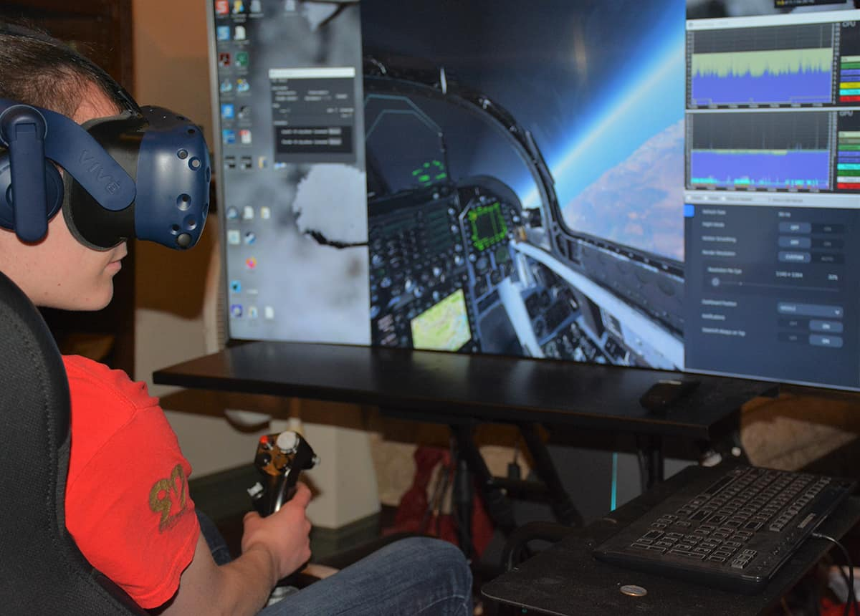
Why would you use it?
Simulate anything
Training
Activities
Notes:
Why would you use it? One of the best things about virtual reality is the possibility to simulate almost anything. It is used to make programs to train future pilots to fly without any real danger or even just to interact with each other in this pandemic. The possibilities are endless. It is also a cheaper alternative for other activities you’d like to do.

Slide 7
Dark side of VR
Not advanced enough
Motion sickness
Notes:
Even though there are so many possibilities. Technology isn’t advanced enough to reach it’s true potential. This is why there are not so many applications. With the current tools to simulate these virtual environments users may experience motion sickness because of the false senses created.

Slide 8
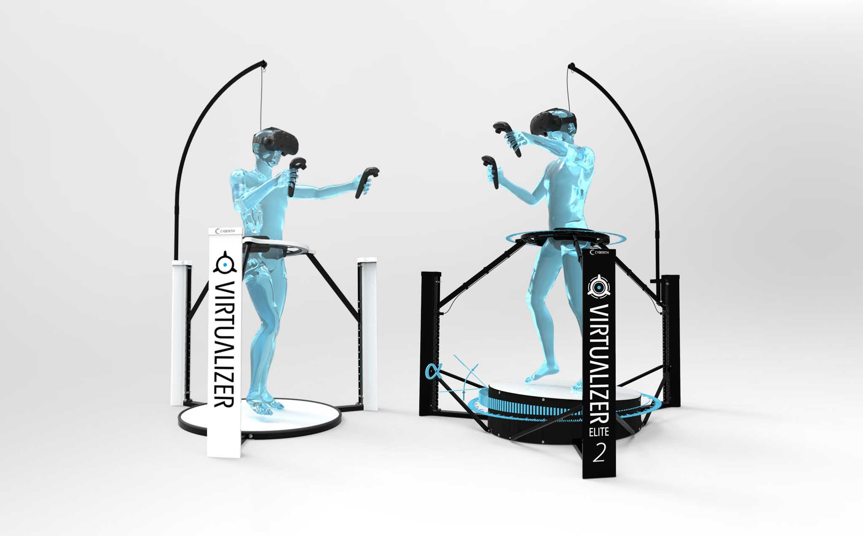
The Future
Fast paced evolution
New technologies
Notes:
But there’s no need to worry if you’re interested in virtual reality because the future is bright for this technology. It has advanced at a fast pace and people are trying to refine and perfect their tools and software to be the best it can be. One of the examples is the company Cyberith who have made an immersive omnidirectional treadmill. Now they are searching for solutions to include the other senses.

